Slide 1



MP-H2: A Client-only Multipath Solution for HTTP/2
Ashkan Nikravesh¹ Yihua Guo² Xiao Zhu¹
Feng Qian³ Z. Morley Mao¹
¹University of Michigan ²Uber Technologies Inc. ³Univeristy of Minnesota
Notes:
Thanks for the introduction, and thank everyone for being here. I’m Xiao Zhu from U of M. Today I’m presenting MP-H2, a client-only multipath solution for HTTP/2.

Slide 2








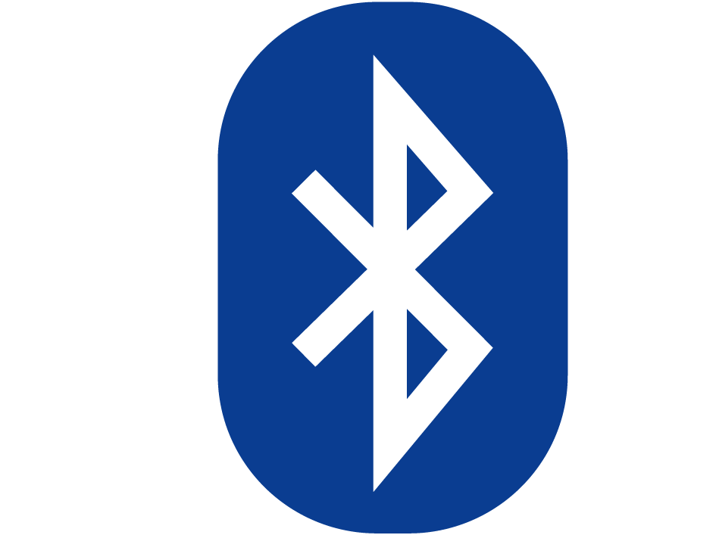
Multipath Transport in Mobile Computing
Simultaneously utilizing multiple network interfaces on mobile devices to transfer data
Mostly realized at transport or application layer
Notes:
Multipath transport / presents rich opportunities / to today’s mobile computers / such as smartphones, smartwatches, and connected vehicles. It utilizes multiple network interfaces / such as WiFi, LTE, and Bluetooth / at the same time / to transfer data / with improved throughput, delay, or reliability.
Existing multipath solutions / fall into two main categories, transport-layer multipath / and application layer multipath.

Slide 3
Limitations of Existing Multipath Solutions
Multipath TCP (MPTCP) has deployment concerns
Only one out of Alexa top 500 websites supports MPTCP
Requires OS kernel changes at both client and server
Many middleboxes strip MPTCP options from TCP packets
Suboptimal CDN server selection
DNS lookup is done only over the primary path
Existing HTTP-based multipath
Suboptimal performance due to poor scheduler design [1, 2]
Target specific applications, e.g., video streaming [2]
[1] J. Kim et al. Multi-source multi-path HTTP (mhttp): A proposal. SIGMETRICS’14 [2] Y.-C. Chen et al. MSPlayer: Multi-Source and multi-Path LeverAged YoutubER. CoNEXT’14
Notes:
However, we found that / they are not good enough.
[click] Multipath TCP / is the de facto standardized solution / of multipath transport. Operating at the transport layer, it achieves good performance / but its adoption / is pretty slow. We scanned the Alexa top 500 websites / and found that / only one of them supports MPTCP.
[click] The main issue is that / MPTCP requires both client and server modification / in the kernel space.
[click] Besides, many middleboxes can block MPTCP / by striping MPTCP options from TCP packets.
[click] Furthermore, MPTCP is not friendly / to many other critical infrastructures / such as content distribution networks, or CDN. Because today’s DNS-based CDN server selection is not aware of MPTCP; as a result, the selected CDN server / is only a good choice for the primary path / and may incur poor performance for other paths.
There are also other / transport-layer multipath solutions / such as Multipath QUIC. And they also have deployment issues.
[click] Existing HTTP-based multipath solutions instead suffer from performance issues / due to poor scheduler design. Some of them are also too application-specific.
In our paper, there are some case studies we conducted / to help better understand and quantify these limitations.

Slide 4
Can we lower the deployment bar of mobile multipath and ensure good performance at the same time?
Notes:
The above issues with existing solutions / definitely motivate us to rethink multipath transport / and seek an answer / to this important question: Can we lower the …

Slide 5



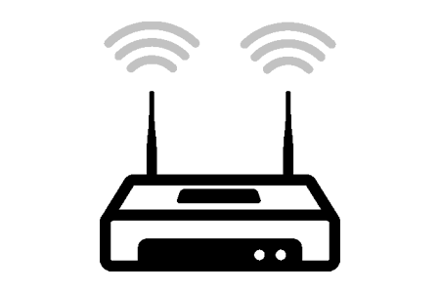

Our Proposal: MP-H2
Client-only, application-layer multipath solution for HTTP/2
Leverages HTTP/2 new features to improve performance
Send separate HTTP byte-range requests over different paths
MP-H2 scheduler determines the distribution
Multi-homing: requests over different paths can be sent to different CDN servers
Request demo.mp4: Range: bytes=0-5000
demo.mp4 = 10000 bytes
Response: Demo.mp4 (0-5000)
Request demo.mp4: Range: bytes=5001-10000
demo.mp4 = 10000 bytes
Response: Demo.mp4 (5001-10000)
Notes:
MP-H2 is our savior. As a client-side, application-layer multipath solution, it requires no server-side changes / and is transparent to different middleboxes / in the Internet.
As its name suggests, MP-H2 is designed on top of HTTP/2 / due to two reasons. First, H2 is getting increasingly popular. Second, and more importantly, H2 introduces new features that provide perfect building blocks / for MP-H2 to ensure good performance.
The high-level idea of MP-H2 / is to send separate HTTP byte-range requests / over different paths / to fetch different portions of the object, as shown in the figure. Then, on the client side, we reassemble the received chunks / before delivering the whole object to the web client. The key logic of MP-H2 / that I’m going to detail soon / is the client-side scheduler design, which determines when to fetch which byte range over which path.
MP-H2 naturally supports multi-homing / where different chunks can be fetched from different servers / as it decouples different paths from the transport-layer perspective. MPTCP instead / allows only one server per connection / and a single CDN server may not be optimal for all the paths.

Slide 6
Requirements and Challenges
R1: Paths need to complete their transfers simultaneously
Otherwise just move some bytes from a slow path to a faster one
Challenging under changing wireless network conditions
R2: Over each path, network bandwidth needs to be fully utilized.
Chunks need to be downloaded without network idle periods between them
Challenging as sending new HTTP requests incurs idle periods on downlink
Notes:
There are two key requirements / to achieve good performance.
[click] First, paths need to / complete their transfers simultaneously, otherwise we can derive an even better download schedule / by moving some bytes / from a slow path to a faster one. R1 is difficult to achieve, because of the potential fluctuating network condition.
[click] Second, over each path, the bandwidth needs to be fully utilized / without network idle periods between chunk downloads. Achieving R2 is trivial in MPTCP but challenging in MP-H2, because sending new HTTP requests / incurs idle periods on downlink.
Existing HTTP-based multipath solutions / fail to meet these requirements / because of their coarse-grained scheduler design.

Slide 7
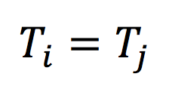
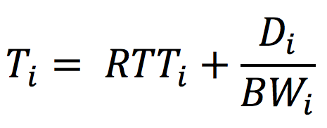
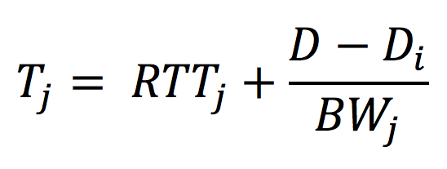
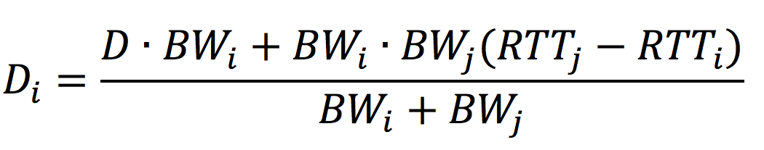
Basic Design of MP-H2
How much data to download on each interface?
R1: Simultaneous completion time on WiFi (i) and cellular (j):
Begin with an ideal scenario where BW, RTT, and D (file size) are all known
Send one HTTP byte-range request over each path (chunk size: D_{i} and D - D_{i}) to fully utilize bandwidth (R2)
D
WiFiW
Cellular
File
D_{i}
D - D_{i}
Notes:
Then / what shall we do?
[click] For ease of presentation, let me describe our design / for two paths, one WiFi and one cellular path. Details of how it can be generalized to more than two paths / can be found in our paper. In this case, the first requirement would be / simultaneous completion time on WiFi and cellular: which is Ti equals Tj.
[click] In an ideal scenario / where BW, RTT, and file size are all known, we can just [click] split the file into two chunks / to fully utilize bandwidth. Because we only need to / send one HTTP request over each path.
So how should we do the split? In other words, how to determine Di? Actually, this is exactly when the simultaneous completion time requirement / comes into play. [click] By deriving the completion time on each path per the chunk size and network condition, and letting Ti equal Tj, we can thus [click] easily calculate Di.

Slide 8
What If Network Conditions Are Unknown
Passively collect bandwidth and RTT samples
HTTP/2 PING to measure latency with high accuracy
Estimate bandwidth and RTT by computing the moving average
Bootstrapping phase
Has no knowledge of either path’s BW and RTT
Notes:
The above scheme is ideal / in that the client needs to know in advance / both the file size and the network condition. Now let us relax these assumptions. Regarding the network condition information, MP-H2 estimates it / by computing the moving average of the bandwidth and latency samples collected passively. For the latency measurement, to achieve high accuracy, we choose to use the H2 PING / instead of measuring it every request/response pair or getting lower-layer information.
One challenge here / is the bootstrapping phase: at the very beginning / of the file transfer, MP-H2 has no knowledge / of network condition / so it cannot use the equation / to split the file.

Slide 9
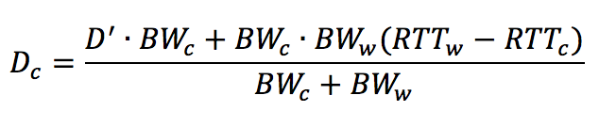
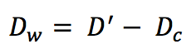
What If Network Conditions Are Unknown (cont’d)
Start with an even split then adjust the byte ranges
D/2
D/2
WiFi
Cellular
D’
WiFi
Cellular
D_{w}
D_{c}
…...
Notes:
To address this issue, MP-H2 initially performs an even split, [click] allowing both paths to start accumulating samples / of network condition readings.
Due to path heterogeneity, typically one path, say the cellular, will finish earlier than the other, say WiFi. [click]
In this case, the cellular then issues a new request [click] to help the WiFi / through downloading part of the data / that was originally assigned to WiFi.
Also, since at this moment / we already have samples / for network condition estimation, we can apply the equation / we just derived [click] to calculate the byte ranges. [click]
If the bandwidth and RTT estimations are accurate, the above process will complete / in two iterations / as illustrated in this figure.
Otherwise, due to imperfect network condition estimation, one path will again / complete sooner than the other path. This leads to another iteration. And this procedure may be repeated for multiple iterations [click] until the difference / between the completion time / of the two paths / is less than a threshold.

Slide 10
More Details in Our Paper
Handle missing file size information
Issue new byte-range requests on a fast path
Judiciously multiplex HTTP/2 requests with measured latency
HTTP/2 flow control to adjust byte ranges on the fly
Instead of HTTP stream cancellation
Notes:
More design details can be found in our paper.
They include / how to handle the missing file size information / without incurring additional overhead,
how to issue new requests / without network idle time / by strategically leveraging the stream multiplexing feature in H2
As well as the rationale behind / using H2 flow control instead of HTTP stream cancellation to adjust byte ranges

Slide 11
Key Evaluation Results
Compare MP-H2 with MPTCP and state-of-the-art HTTP-based multipath solutions
On Android smartphones with WiFi and LTE connectivity
 | MP-H2 vs MPTCP | MP-H2 vs HTTP-based solutions
File Download | 6% slower on average | 26%-47% faster (vs mHTTP [1])
Video Streaming | 0.3%-8% lower bitrate | 25%-44% higher bitrate (vs MSPlayer [2])
[1] J. Kim et al. Multi-source multi-path HTTP (mhttp): A proposal. SIGMETRICS’14 [2] Y.-C. Chen et al. MSPlayer: Multi-Source and multi-Path LeverAged YoutubER. CoNEXT’14
Notes:
To show the effectiveness of MP-H2, we extensively evaluate it / under different network conditions and workloads/ over commercial WiFi and LTE / on Android smartphones. We quantitatively compare our solution / with MPTCP / and the state-of-the-art HTTP-based multipath solutions.
For the main results, MP-H2 offers only slightly degraded performance while being much easier to deploy compared to MPTCP. Compared to other state-of-the-art HTTP-based multipath solutions, MP-H2 reduces the file download time by up to 47% and increases the video streaming bitrate by up to 44%.

Slide 12
Key Evaluation Results (cont’d)
Multi-homing
Reduces the average file download time by 4%-19% compared to using a single server
Pipeling requests through HTTP/2 stream multiplexing
Improves the median download time by 25%
Tail bytes elimination
Reduces the tail bytes by 10x compared to using the HTTP/2 stream cancellation mechanism
Notes:
We also show through micro-benchmarks / that the optimizations introduced by MP-H2 / such as multi-homing, pipelining, and HTTP flow control can help improve the performance / and save date usage.
More results can be found in our paper.

Slide 13
Limitations and Future Work
Lack of support for data upload over multipath
Not many servers accept byte-range HTTP PUT requests
A data upload typically does not support multi-homing
Some of the design relies on HTTP/2
Pipelining, HTTP PING, HTTP/2 flow control
HTTP/1.1 fallback
MP-H2 for QUIC
Notes:
There are / a few limitations.
First, MP-H2 lacks support / for data upload over multipath. Because not many servers / accept byte-range HTTP PUT requests / and a data upload typically / does not support multi-homing.
Besides, in case a server only speaks HTTP/1.1, MP-H2 has to disable all H2-specific features and only uses the high-level scheduling approach. This would inevitably lead to performance degradation compared to full-fledged MP-H2 for H2.
Meantime we are looking for practical techniques to address this performance concern.
We are also working on porting MP-H2 to QUIC whose most features are very similar to those of H2.

Slide 14
Conclusions
Mobile multipath faces deployment & performance obstacles
MP-H2 to the rescue
Client-only multipath over HTTP/2
Judiciously balance all paths’ workload
Strategically leverage new HTTP/2 features
Thank you! Questions?
Notes:
Thanks a lot / for your listening. And I’m ready / to take questions.

Slide 15
Conclusions
Mobile multipath faces deployment & performance obstacles
MP-H2 to the rescue
Client-only multipath over HTTP/2
Judiciously balance all paths’ workload
Strategically leverage new HTTP/2 features
Thank you! Questions?
Notes:
Thanks a lot / for your listening. And I’m ready / to take questions.

Slide 16
Conclusions
Mobile multipath faces deployment & performance obstacles
MP-H2 to the rescue
Client-only multipath over HTTP/2
Judiciously balance all paths’ workload
Strategically leverage new HTTP/2 features
Thank you! Questions?
Notes:
Thanks a lot / for your listening. And I’m ready / to take questions.

Slide 17
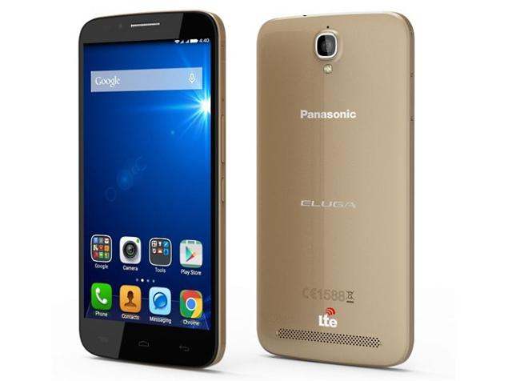
Interplay between MPTCP and CDN Server Selection
CDNs use DNS to direct users traffic to the best server
Sub-optimal DNS-based server selection for MPTCP connections
The DNS request to resolve the domain is only sent over the primary path
Affect the performance of the secondary path and therefore MPTCP
closer
Internet
./
Notes:
To accelerate the delivery of web contents with global reach to users, CDNs replicate the same content across servers at multiple geographically distributed locations.
DNS-based server selection can still work in MPTCP, but it may cause performance issues. The problem is that, for an MPTCP connection, the DNS resolution is done only over the primary interface [click], so the IP returned by the local DNS server may not be close to the secondary interface [click]. [click] And this will affect the performance of the secondary path and therefore the MPTCP connection.

Slide 18
Impact of Sub-optimal Server Selection on Performance
This problem becomes worse when the content is stored inside the access network.
Case study: Netflix
Over WiFi, round-trip latency to IP_{WiFi} is 4ms and to IP_{CELL} is 25ms.
5x increase in the latency of WiFi path
20% increase in the download time of a 1.6 MB video file.
AT&T
IP_{CELL}
Internet
IP_{WiFi}
Campus network
Notes:
As an example, this figure shows the location of its content servers when streaming video through AT&T network and our campus network. If the DNS lookup is done over the cellular interface rather than the WiFi interface, we will have 5x increase in the latency of the WiFi path as the WiFi traffic will be “detoured” into the cellular access network.
In terms of download time, it translates to a 20% increase when we download a 1.6 video file that was hosted by these servers. With smaller video chunks, the client will experience substantially longer download time.

Slide 19
Optimal CDN Server Selection for MPTCP
Highest “utility” to serve all paths
Consider each path’s characteristics (e.g., bandwidth, delay)
May still under-utilize the overall system capacity
Internet
./
./
Multi-homing
Simultaneously using multiple CDN servers
On each path, the client contacts the closest server
However, MPTCP doesn’t support multi-homing
Notes:
An ideal server selection would perform DNS lookups [click] over all paths [click] and pick the best server IP [click] that yields an overall highest “utility” [click] to serve all paths. However this approach requires DNS modification to make it MPTCP-aware and may still under-utilize the overall system capacity, because a single CDN server may not provide optimal performance for all paths.
[click] To fully utilize the system capacity, multi-homing would be necessary where on each path, the client performs a separate DNS lookup and fetches the content from the selected CDN server, however MPTCP only allows one server per connection and cannot support this multi-homing scheme.

Slide 20
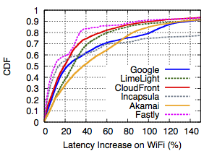
Impact of Sub-optimal Server Selection on Performance
Crowd-sourced measurement of multipath latency
Comparing the RTT to IP_{WiFi} and IP_{CELL} over WiFi.
123K samples, collected during 5 months from 138 devices, covering 71 carriers.
IP_{CELL}
Internet
IP_{WiFi}
Median increase in the WiFi latency is 10% to 40%.
Over cellular, median increase is between 5% to 20%.
Notes:
To understand how prevalent the above suboptimal server selection is across today’s CDNs and ISPs, we conduct an IRB-approved crowd-sourced measurement study using a custom measurement app we released on Google Play. We measure the latency difference of client to the servers selected by the WiFi and cellular Local DNS over WiFi and repeat this over cellular.
We find that the median increase in the WiFi latency is 10% to 40% for the six popular CDN providers we selected. The cellular latency difference is smaller due to a higher base latency.

